Slide 1
Key to Filling Out Your Family Tree

Slide 2
WHO? who of owl

Slide 3
WHO AM I?
WHO ARE WE?

Slide 4
The Family Tree is Vital to Answering the Question of Who am I

Slide 5
Key to Family Tree Success is a Good Set of Resources (to open the doors) The H-H DNA Surname Project is a key to unlocking vital resources.

Slide 6
The Haworth-Howarth Surname Project
This project resides on the FamilyTreeDNA.com website.
It helps all Haworths, Howarths, Hayworths, etc., find their roots and fill out their family trees.
To join the project, one needs to take a DNA test, either the paternal test (YDNA) for men or the Family Finder test (autosomal) for women and men. Women and men are equally welcome. Women often join with their male relative YDNA results in hand.
There is a team of Haworths-Howarths in the project who can help you every step of the way.

Slide 7
Descendants of George the ‘Immigrant’
Many members of the Surname Project are descendants of George the ‘Immigrant’ (1676-1725) and also members of the Haworth Association.
Other members of the Project trace their roots to Lancashire and Yorkshire England and have a Haworth-Howarth surname (or a variation thereof) but are not descendants of ‘George.’

Slide 8
Visit the Project Website
Click on www.FamilyTreeDNA.com to get started. One has to order a DNA test to gain the full extent of project’s resources. Information on ordering these tests is covered on the first page of the website.
The project website has a wealth of history and background on Haworths, as well as guides to exploring one’s genealogy/ancestry through DNA research.

Slide 9
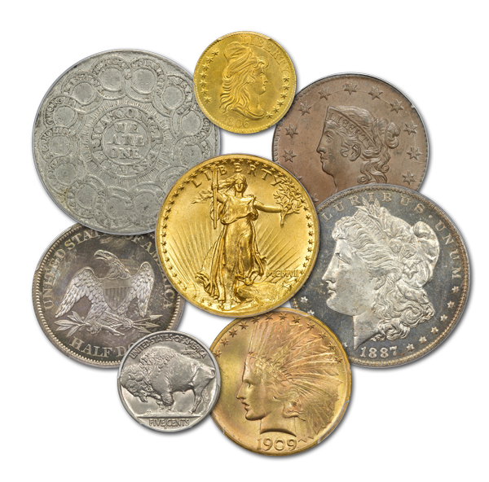
Help on Paying for DNA Test? We can help!

Slide 10
We are here to help you!
The management team of the surname project consists of seven members, who are ready to help you:
Loran Haworth, email – skyloran@gmail.com
Bill Barnes-Howarth, email – billsgenealogy6636@gmail.com
Marilyn Totten, email – mlwinton@hotmail.com
Todd Irvine Haworth, email – irvinesartifacts@aol.com
Glen Haworth, email – cardinal__00@gmail.com
Carl Haworth, email – cehaworth@gmail.com
Hugh Haworth, email – hrhcapital@yahoo.com
Others including Ron and Jessie Haworth, who are also ready to help you.

Slide 11
Yes, We Can Answer Your Questions!
Questions on the Haworth-Howarth Surname Project
Getting into the project website
Navigating the systems their and optimizing your experience
Questions on DNA Testing
Which of three major test is best for you
What do the test results mean
What do you do with the test results

Slide 12
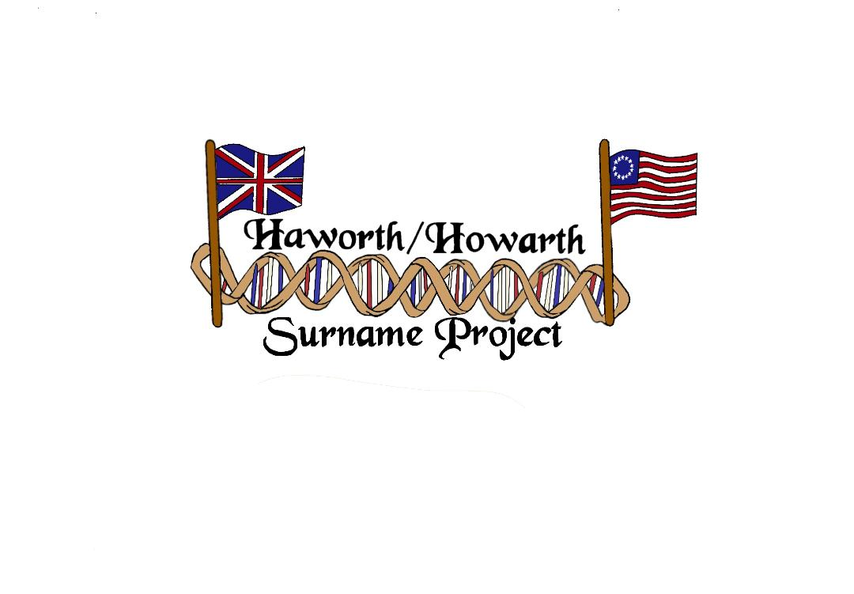
We have fun, too!
Though there is a serious side to our work, we have fun, too.
We have devised a logo that symbolizes our group.

Slide 13
Look who created our logo – Emma, one of the younger faces of the group.

Slide 14
Questions?
Please ask away - anything of interest to you about this project, DNA testing, or family trees.

Slide 15
Slide Show?
If you would like a copy of this slide show, please ask any of us for a copy. We will send it to you pronto.

Slide 16
THANK YOU!

