Slide 1
FAMILY HISTORY PRESENTATION NO. 1 George Haworth
His Lancashire Background
Marilyn Totten and Sharon Castle

Slide 2
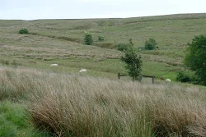
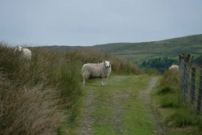
The Land
First Haworths mentioned by surname in Court Rolls of 1495. Rossendale was a Royal Hunting Forest of the English monarchs. Henry VII “disafforested” Rossendale in 1507, raising money by “renting out” for a period of years, units of land held by “copyhold” leases by individuals from the Crown. The earliest mentioned Haworths held one of the seven “vaccaries” or cattle stations.

Slide 3
1500’s and 1600’s were a time of large population growth. Many branches of Haworth families developed in different Rossendale locations. Not as much land was available for younger sons. People were mostly farmers of small holdings, and shepherds. Many were involved in the developing wool and cloth trade, mostly as small family “cottage weavers.”

Slide 4
ROSSENDALE

Slide 5
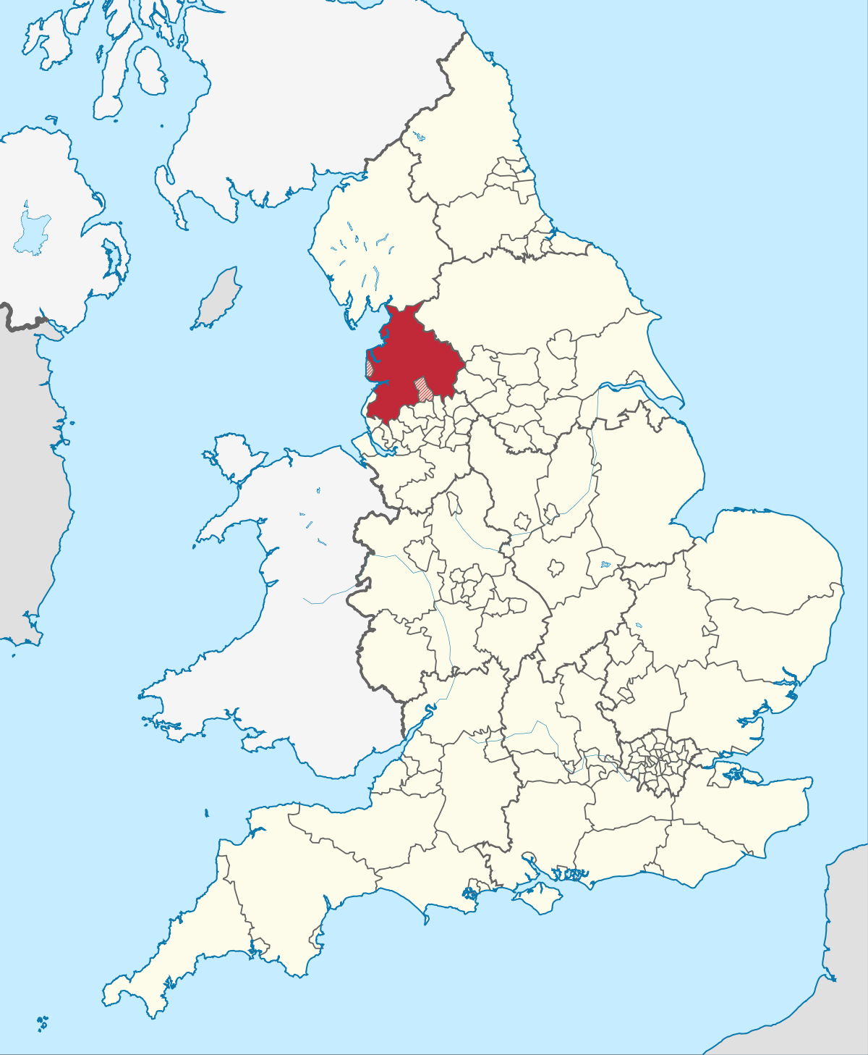
ROSSENDALE LANCASHIRE

Slide 6
The Years of the English Civil War 1642-1651 Troubled and turbulent times; Rossendale was mostly for rule by Parliament rather than by a monarch. Order was disturbed and parish registers and court rolls were poorly kept, sometimes with large gaps. James Haworth and Isabel (George’s parents) were growing up into their teen years amongst a disturbed society.

Slide 7
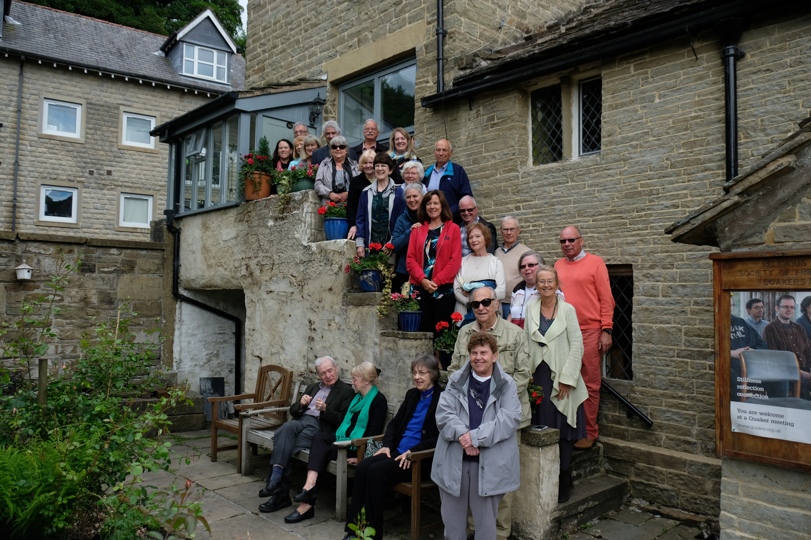
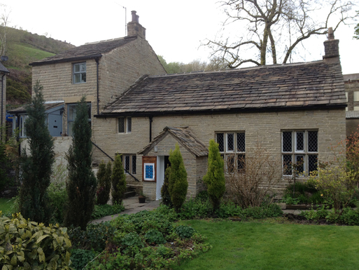
THE APPEARANCE OF “NON-CONFORMISTS”
Amongst a society where order had suffered, people began to feel more free to think for themselves. George Fox, the founder of Quakerism, was one of these early “thinkers”. He traveled around central and northern England, and spoke to a gathering in 1652 on Pendle Hill, roughly ten miles north of Burnley. People in Rossendale were not far away. The first meeting was organized by Henry Birtwisle around 1658; the meeting house at Crawshawbooth built in 1716. George and brother James were raised as Quakers, probably through their mother Isabel’s family; both brothers were tutored at home, and were literate. See https://heritage.quaker.org.uk/files/Crawshawbooth%20LM.pdf for good article on the meeting house.

Slide 8
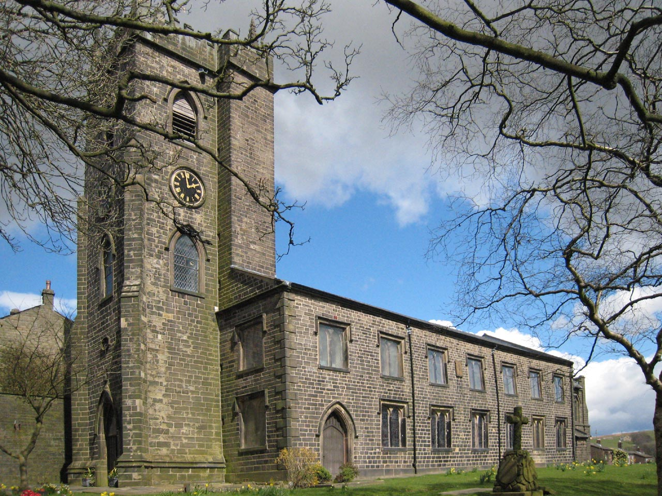
George the Immigrant’s Family
George was youngest child of James Haworth and wife Isabel (maiden name unknown). Born probably at Windybank Farm, part of an area called Gambleside. Baptized 10 Sept 1676 at Haslingden, St James. Father James died two years later; no evidence he was a Quaker.
George’s siblings were Mary (1662); Sarah (1665); James (1667); Alice (1669); Susannah (ca1673); George (1676).
No marriage ever found for George’s parents. Probably married by private Quaker “civil” ceremony, about 1660.
St Nicholas, Newchurch-in-Rossendale, where George’s father James was buried 1678.

Slide 9
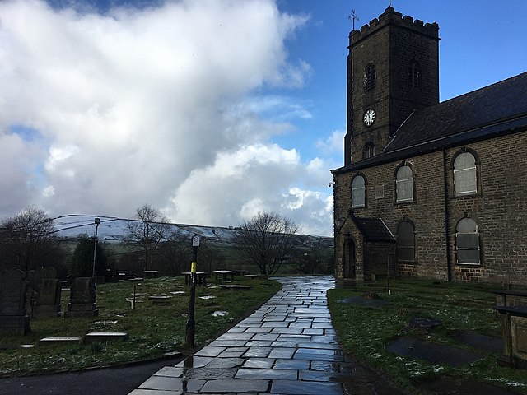
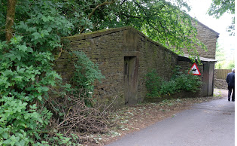
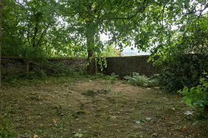
Isabel ____ Haworth Ormerod was buried 1707 at Chapel Hill FBG – established 1663
St James, Haslingden – top right;
Windybank Farm – bottom right.

Slide 10
George’s Early Life
Perhaps he lived part of it with Henry Birtwisle, who probably tutored him in reading and writing. George often asked after Henry in his letters home.
When he was 9, his mother Isabel remarried to John Ormerod. No half-siblings. After John’s death, Isabel and probably George, lived with his brother James who was a sub-tenant but later obtained the copyhold lease of Hapton Hall Farm (photo to right). James as the eldest son, inherited the major part of his father’s estate. Their father James must have died rather suddenly, as he did not leave a will. I found his inventory, and his probate by his widow Isabel. Therefore George, as a younger son, needed to make his own way and “spare land” was becoming scarce.
Isabel was living here with her son James, when she died 1707; buried at Chapel Hill Friends Burial Ground.

Slide 11
THE “SUFFERINGS” AND THE EMIGRANTS
Quakers wrote down their persecutions under the Church of England and the Crown, in records called “Sufferings”. An example to the right, shows the 1691 imprisonment of George’s brother James Haworth, Henry Birtwisle, and George Heyworth or Haworth, probably a cousin, in Lancaster goal (jail).
“All 32 were committed prisoners upon attachments out of the Exchequer for not putting in their answers upon oath…..in a case of Tythes which they could not pay…..for conscience sake.”
Many Quakers were brought to a pauper’s state through unjust fines and appropriating goods, stock and crops. Young men, especially younger sons, were offered a way out by emigrating to William Penn’s Quaker Colony of Pennsylvania.

Slide 12
FROM “EMIGRANT” to “IMMIGRANT”
The records of Crawshawbooth Friends Meeting in 1699 note that “John Kenworthy and family” were intending to remove to Pennsylvania. This included George, his sister Alice, wife of John, their young son James, and a baby on the way. The family, all but George, died of the typhus or yellow fever outbreak on the ship “Britannia” during the 13 week voyage. Thus it was called “that sick ship from Liverpool.” George was extremely ill and we’re fortunate he survived to arrive in America!

