Slide 1
Family History Part 2: George’s Life in Bucks County, PA
Sharon Castle and Marilyn Totten

Slide 2
Map of Lower Bucks County

Slide 3
In George’s Words
“I hired myself out and had about £19 wages in the year and since I was free [not indentured] I work by the piece or by the day.”

Slide 4
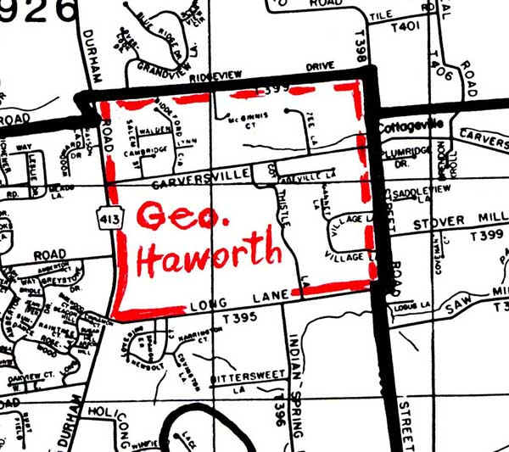
Present Day Map of George’s Land

Slide 5
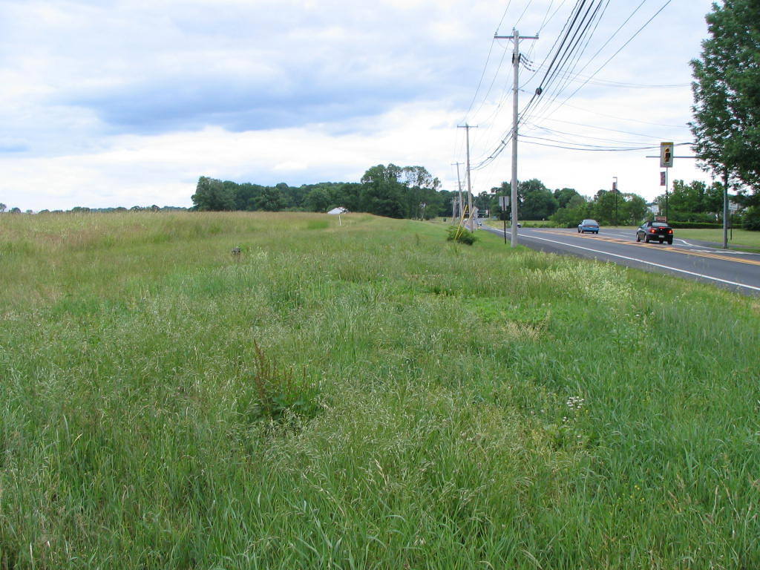
Present Day Photo of George’s Land

Slide 6
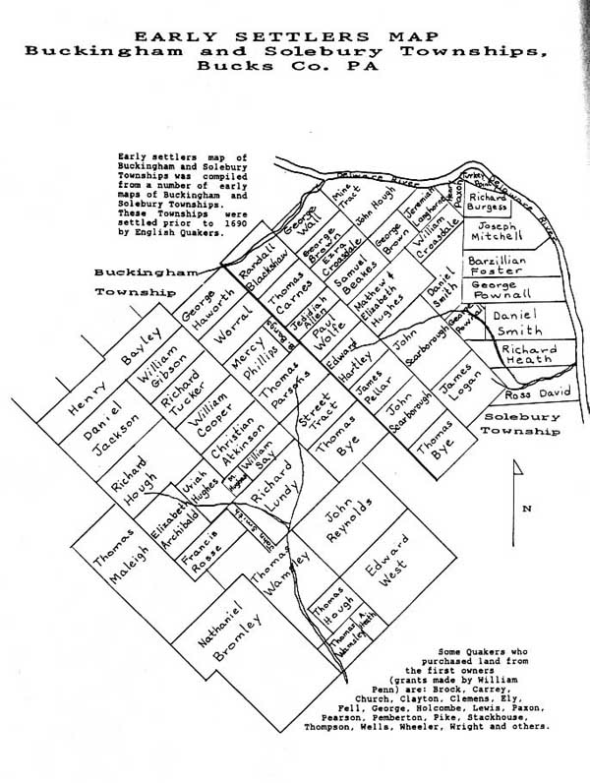
Map Showing Haworth and Scarborough Land

Slide 7
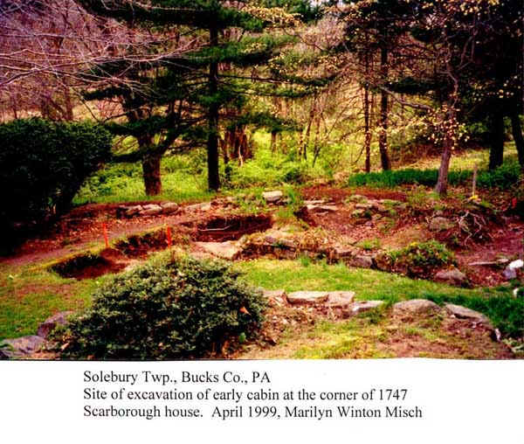
Photo of Scarborough Land

Slide 8
Children of George and Sarah
Infant, b. 1712, d. 1712
Stephanus, b. 1713
Rachel, b. 1715
Absalom, b. 1716
John, b. 1717
James, b. 1719
Mary, b. 1721
George Jr., b. 1724

Slide 9
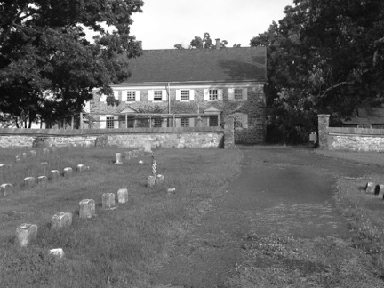
Buckingham Friends Meeting

Slide 10
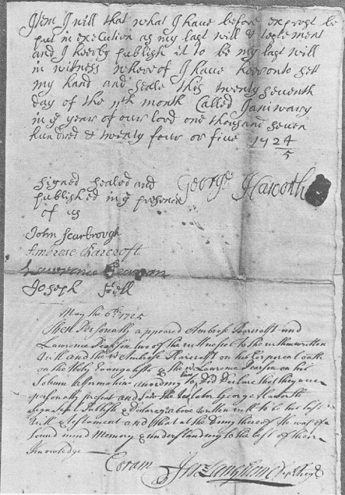
George’s Will

Slide 11
George’s Signature

