Slide 1
James Haworth II “The Pioneer”
Born 1752, Back Creek Settlement, Frederick Co., Virginia.
He was 6 years old when lost his father James. Mother Sarah given financial aid by Hopewell Meeting. They had been driven from their home due to Indian troubles; the French and Indian War. They saved household goods, 4 cattle and 4 horses; they lost 12 head of cattle.

Slide 2
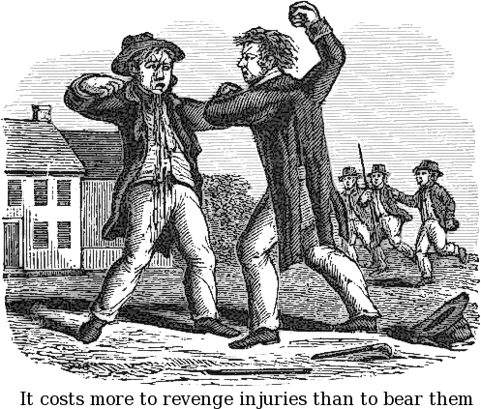
MOVE TO BUSH RIVER MEETING, NEWBERRY COUNTY, S.C.
When James was 8 his mother remarried in 1759 to Peter Ruble, a widower with young children. James and brother George grew up with a stepfather in a large blended household. They all moved to Newberry County, S.C. in 1768 when James was 16; his mother Sarah died a year later. This could explain the “wild ways” of James and his brother George, two years older….leading up to their disownment three years later in 1772, for “drinking, swearing, fighting and using unbecoming language.”

Slide 3
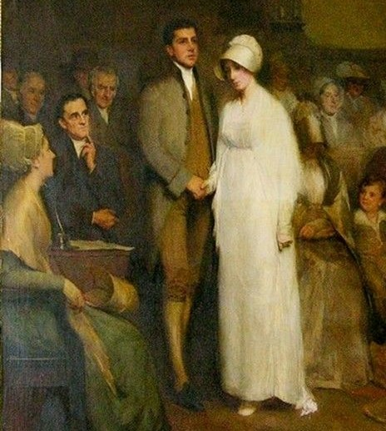
TENNESSEE YEARS – AND JAMES’S MARRIAGE
James was not received back into membership until 1794 – at New Hope Meeting, Greene Co., TN – 22 years after his disownment. He was there before 1784 when he married Mary Rees, daughter of William Rees and Charity Dillon; he was 32, she was 17! Bought 200 acres in 1792.
Legend has it that James and brother George accompanied Daniel Boone on one of his early trips into the Kentucky wilderness, but they turned back to NC/TN because of the hostile Shawnee.
Some say James went to Tennessee on the Holston River during the Revolution (1776-1780) to avoid conscription.

Slide 4
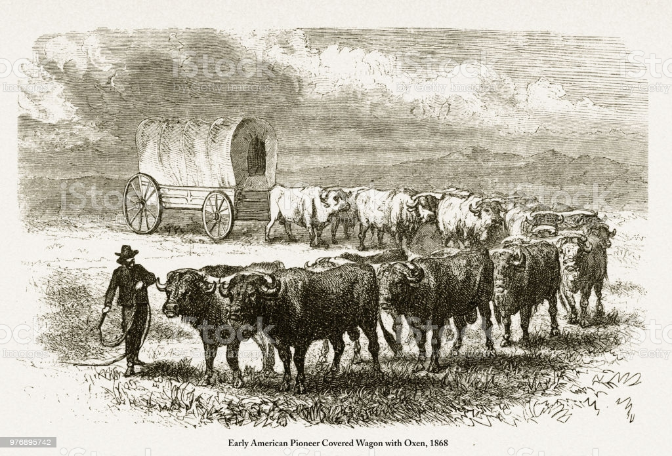
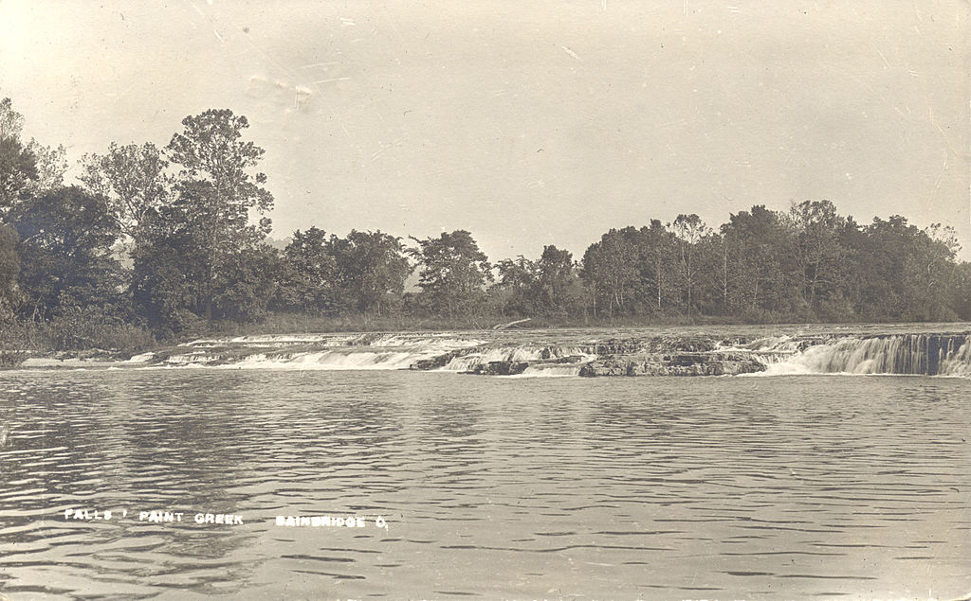
INTO THE WILDERNESS OF OHIO 1801-1802
In 1801 a group of pioneers over-wintered at the Falls of Paint…… “the father of Wm Wright and family; JAMES HAYWORTH; and Seth Smith. This party met with much hardship on their journey” and brought with them a drove of 60 or 70 cattle. They had to cut their way through the woods, by now the Spring of 1802, until they reached the present site of Leesburg.”
They marked out home sites; built one by one. First one raised was James Haworth’s. Three families made up the entire settlement, even then they were 2 or 3 miles apart. “Many of the Indians became quite sociable. The settlers learned some words of their tongue, and the Indians were quite communicative; all were friendly.”
Below are the “Falls of Paint”, Bainbridge, Ohio

Slide 5
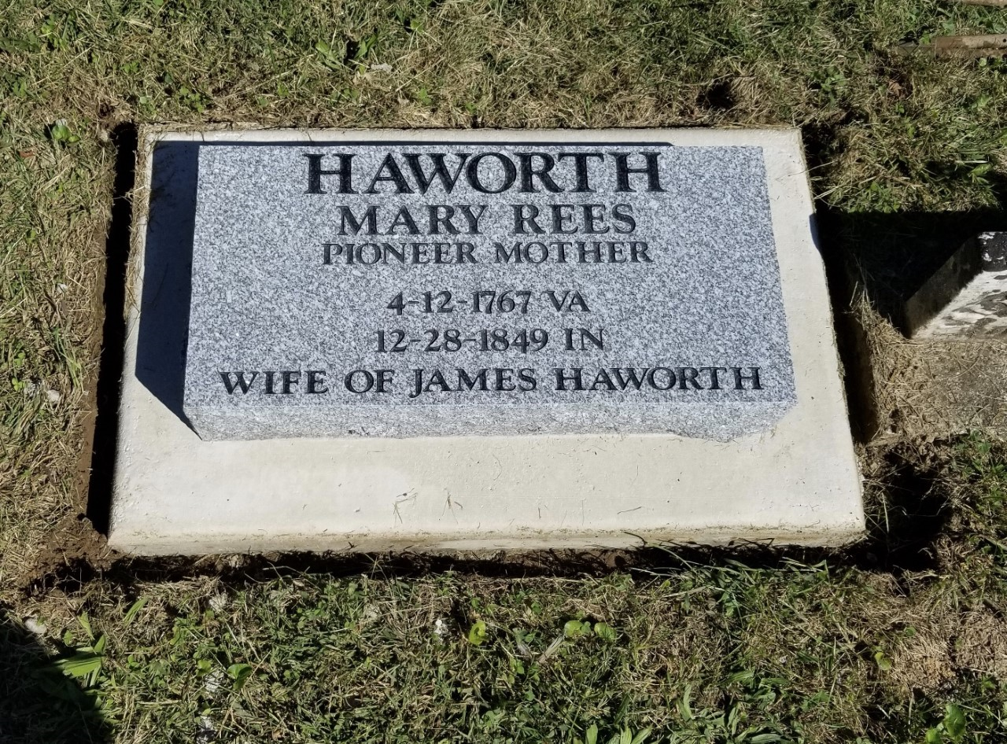
HIS LAST 26 YEARS – OHIO TO INDIANA
Lived 23 years on Lees Creek, Highland County, OH. In 1824 to Randolph County, Indiana; but on to what is now Hendricks County, Indiana. Purchased 80 acres in 1825.
James died on his farm not far east of Danville, Indiana, aged 75. Will probated 1827. One of the first to be buried at Mill Creek FBG, towards the back (north) end, in a grave marked only by a field stone. He must have had a strong constitution after the hard physical exertions of his life as part of the Westward Movement. Earlier generations did not live so long (James Sr. , 38; George the Immigrant, 49; his father James, 47).
His widow Mary Rees Haworth, after 14 children, lived with various sons, and lastly with son Jonathan and wife Esther Evans Haworth. She died in 1849, aged 82! It is hard to imagine the hardships of her life. She is buried in Hinkle Creek FBG, Hamilton County, Indiana. Old stone broken, new stone erected 2018 by myself, brother Richard C. London, and Greg Hinshaw.

