Slide 1
Stephanus Haworth
1713-1765

Slide 2
Stephanus Haworth
Stephanus Haworth was born February 17, 1713, in Bucks County, Pennsylvania. He was the second child of George Haworth and Sarah Scarbrough. Their first born, a son, died as an infant.
At the time of his birth his father owned land, but the family was still living in a cabin on land owned by Sarah’s parents. His father died when he was 11 years old and soon after his mother married Matthew Hall.

Slide 3
George’s land divided among his children

Slide 4
Migrating
By 1737 Stephanus had sold the 63 acres of land he inherited from his father to Francis Hough. (Hough then sold it to a Mr. Jones who then sold it to Matthew Hall.) He and his brother Absalom then joined their uncle Robert Scarbrough in migrating to the Shenandoah Valley of Virginia.

Slide 5
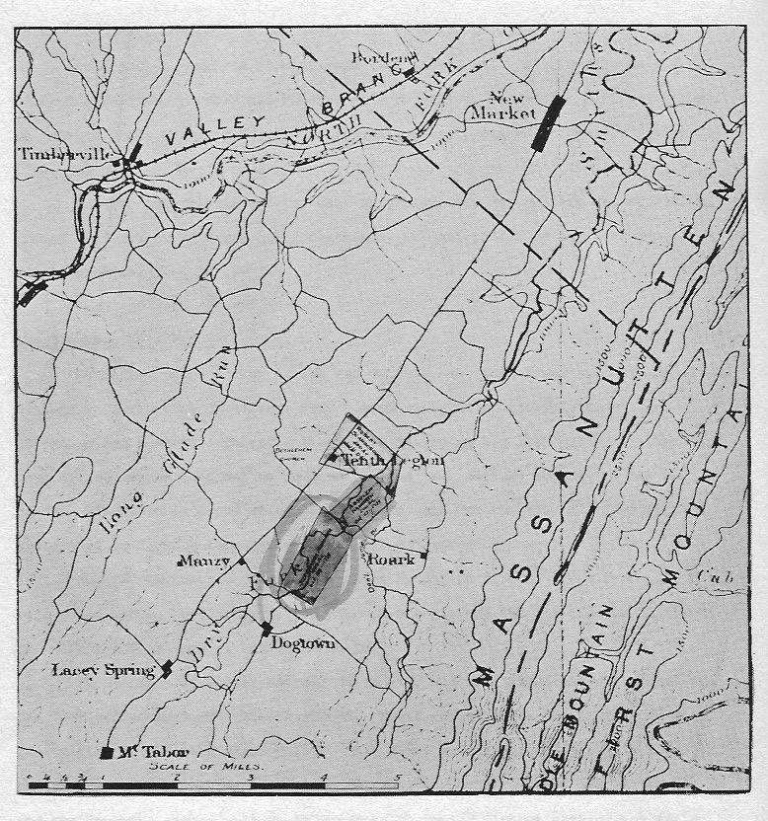
Shenandoah Valley Top box is Robert Scarbrough’s land Middle box is Absalom’s land Bottom box is Stephanus’ land

Slide 6
In the Shenandoah Valley
Here he bought 400 acres of land with Smiths Creek, a branch of the North River, running through it. This land was 50 miles south of Opequon, later Hopewell Monthly Meeting. In 1738 he reported to the Buckingham Monthly Meeting that he and his brother Absalom requested a certificate to the Opequon Monthly Meeting. His brothers James and John joined them there in 1739
In 1740 he married Rachel Beeson at Hopewell Monthly Meeting. Rachel was born in 1724 in Pennsylvania, she was the daughter of Richard Beeson and Charity Grubb.

Slide 7
Guilford County, North Carolina

Slide 8
On to North Carolina
By the late 1750’s land has become expensive in the valley, native tribes had become dangerous, and Absalom and James had died. By the early 1760’s Stephanus and Rachel, along with Rachel’s parents had moved to Rich Valley Creek, in Rowan, now Guilford County, North Carolina.
Stephanus and Rachel had eight children, all lived to adulthood.

Slide 9
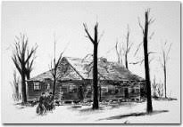
Deep River Friends Meeting House

Slide 10
Stephanus died September 19, 1765, in Rowan County, North Carolina. We are unsure of where he was buried, maybe on the family farm or maybe at Deep River Friends Burial Grounds. In 1766 Rachel married Anthony Chamness. Rachel died in 1775 and was buried at Deep River Friends Burial Grounds in Rowan County.

