Slide 1
15. Absalom Haworth
1716 - 1752
Please view incorporated “Notes” for additional information.
Notes:
Starting with (#1) - William Scarborough, born 1598 - each subsequent descendant named in “Some Quaker Families – Scarborough|Haworth” with significant information in a following generation has been given a number. Absalom Haworth, the son of George (“the emigrant”) Haworth and (#7) Sarah Scarborough Haworth, is #15 in this lineage tracking format.
Readers of this presentation are cautioned to heed the sage advice (paraphrased here) of Marilyn Totten when studying this genealogy, “Do not believe anything contained in (it) as having been verified.” Errors have been found in original documents. Transcribing errors abound.
“Absalom” is sometimes spelled “Absolom.”
Absalom, the ancestor to whom this PowerPoint refers, will sometimes appear as “Absalom, Sr.,” to distinguish him from his son, “Absalom, Jr.”
Absalom’s birth is usually dated to 1716; however, at least one source was found to differ. Likewise, most sources for this presentation state his year of death was 1752; however, that year is not unanimously held. Some sources ascribe the occurrence of a specific event to a single, specific day; other sources broaden dates to a wider range of weeks, months, or even years.
Confusion regarding dates was exacerbated in 1752 when the British Colonies, under Great Britain's control, changed from the Julian Calendar to the Gregorian Calendar.
New Year’s Day, when the calendar year is increased by one, had been celebrated on March 25th, but was now to be celebrated on January 1st of each year.
Furthermore, the day following September 2, 1752, was September 14, 1752, to synchronize the calendar with the solar cycle.
And, worldwide, the transformation to the Gregorian Calendar, one country at a time, took from 1582 to 1926/1927.
Thus, precision steps required to arrive at an exact date for an event in the early 1700s and earlier, prior in the British Colonies, would necessitate describing the multiple possible lenses/pathways, incorporated or disregarded, that lead to an exact date conclusion. Finding original documents that were produced at the time of an event and include the date and geographical location are invaluable.

Slide 2
Absalom Haworth – Abbreviations:
(SQF; Vol; Pg.) Some Quaker Families: Scarborough\Haworth; Volume; Page Number
(FSO; Sou, Col, or Mem): FamilySearch.org; Identifier and Title for Source, Collaborate; Memories
(Rootsweb): rootsweb.com
(Ancestry): ancestry.com
(AFH): anAmericanFamilyHistory.com
(MHFT): MyHeritage Family Trees
Notes:
Enclosed within parenthesis are the abbreviations used in this presentation for the more frequently cited sources of information.

Slide 3
Absalom Haworth – Research Limitations:
“In 1757, the Hopewell meeting house burned and the early records were lost.”
(Hopewell Friends Meeting in Frederick County (anamericanfamilyhistory.com)
Swarthmore College, Swarthmore, PA – U.S. Quaker Meeting Records 1681- 1935, i.e.:
Buckingham Monthly Meeting, PA
Hopewell Monthly Meeting, VA
New Garden Monthly Meeting, PA
Nottingham Monthly Meeting, PA
Notes:
Hopewell Friends Meeting in Frederick County (anamericanfamilyhistory.com)
Several members in our Haworth|Scarborough lineage were active members of the Hopewell Meeting House prior to 1757. Their early records were lost in the 1757 fire.
Other limitations to research stem from the physical condition of the hand scribed pages that survived 300 years in storage. The remaining faint penmanship sometimes disappears into lines too faint to be enhanced electronically.
Swarthmore College, Swarthmore, PA, is one of many libraries across the United States whose collections include numerous original and/or electronically scanned copies of Monthly Meetings and other resources.

Slide 4
Absalom Haworth – Birth:
When:
(SQF, Vol. 1; Pg. 12): “1716”
(FSO; Coll; “Absalom”): “About 1716”
(FSO; Person; Absalom Haworth): “5 April 1716”
(rootsweb): “1714”
Where:
(SQF, Vol. 1; Pg. 12): “Solebury Township, Bucks County, PA”
(FSO; Coll; “Absalom”): “Solebury Township, Bucks County, Pennsylvania”
Notes:
The red Font Color is used in these slides to highlight differences in data for a given event.
For instance, the date of Absalom’s birth in stated as “1716,” “About 1716,” “5 April 1716,” and “1714” in the listed source documents.
Agreement is apparent in Absalom Haworth’s place of birth – Solebury Township, Bucks County, Pennsylvania.
Rootsweb.com “Birth: abt 1714, Bucks co, PA

Slide 5
Absalom Haworth – Parents:
(SQF, Vol. 1; Pg. 12): “Son of Sarah Scarborough and George Haworth”
(rootsweb) Parents: “George (‘The Immigrant’) Haworth and Sarah Scarborough”
Notes:
George Haworth and Sarah Scarborough are unanimously identified as the parents of Absalom Haworth.

Slide 6
Absalom Haworth – Marriage:
(SQF, Vol. 1; Pg. 12) 1738. Elizabeth E. Payne. Frederick County, VA
(FSO; Coll; “Absalom”): “… he married Elizabeth Payne in 1738.”
(rootsweb): “abt 1738, Frederick co. VA”
MyHeritage Family Tree): Elizabeth D. (also “F.”)
(SQF, Vol. 1; Pg. 12) “Some family members believe he married Rachel Lewis.”
Notes:
Elizabeth Payne’s middle initial, if listed, most often is an “E.” However, a “D.” and an “F.” were found.
I have no further information regarding the assertion that Absalom had married Rachel Lewis.

Slide 7
Absalom Haworth – Elizabeth Payne:
(SQF, Vol. 1; Pg. 12): “A Quaker.” “Elizabeth was born 12-5-1724, the daughter of Josiah Payne and Martha Sheppard.”
(FSO; Coll; “Absalom”): “… born on December 5, 1724.” “She was the daughter of Josiah Payne and Martha Shepherd.”
Notes:
The birth name of Elizabeth Payne Haworth’s mother was spelled in sources as either “Sheppard” or “Shepherd.”

Slide 8
Absalom Haworth – Children:
(#54) Nathaniel: 1740 – 1790
(#55) Absalom, Jr.: 1743 – 1826
Richard: 1744
Mary: 1745 – 1815
Wilma: 1747 – Deceased
Hannah: 1748 – 1774
Notes:
Absalom, Jr., is sometimes spelled Absolom.
An American Family History (https://www.anamericanfamilyhistory.com/Haworth%20Famliy/Haworth%20Absalom%201716.html) includes an additional child – “Richard Haworth (1944)” – with no further information. The page does not include a “Wilma Haworth,” described below.
In familysearch.org, a tree of Absalom Haworth and Elizabeth E. Payne (Absalom Haworth (1716–1752), Elizabeth E Payne (1724–1752) | Portrait View | Family Tree | FamilySearch) displays an additional child – “Wilma Haworth, 1747-deceased * 9V32-MY6.” The tree does not include a “Richard Haworth,” described above.
Two sources made passing note that Absalom and Elizabeth had up to 10 additional children. Suspicion is raised that those author(s) may have confused the children of James Wade Haworth to gain that number.

Slide 9
Absalom Haworth – Death:
(SQF, Vol. 1; Pg. 12): “17 April 1752.” “Frederick County, VA”
(FSO; Coll; “Absalom”): “… settled near his brother Stephanus and died there in Virginia in April or May of 1752.”
(FSO; Person; Absalom Haworth): “17 April 1752”
(Rootsweb): 17 Apr 1752, Frederick co, VA
(MHFT): 1751
Notes:
“Some Quaker Families,” Pg. 12, states Absalom died 17 April 1952, his will was dated 17 April 1952, and proved 2 June 1952 in Frederick County, VA. The author of this presentation has not examined original documents to verify this information.
The author of this presentation wonders if “April or May of 1752” and “1751” source dates may have originated from confusion stemming from attempts to translate to the Gregorian Calendar dates of events that occurred in the Julian Calendar era. (See Notes on Slide #1)

Slide 10
Absalom Haworth – Locations:
(SQF, Vol. 1; Pg. 5): “After their marriage (~1710), George (Haworth) and Sarah (Scarborough-Haworth) settled in Upper Buckingham Township, Bucks County, PA. They lived for a time in a cabin built for them on the Burn Brindle (sic?) Hill property, just below John Scarborough’s house. The eldest of several children were born there. (→1716?)
Absalom was the second born, thus may be considered one of the “eldest”.
“Later they lived near Lahaska, Solebury Township, Bucks County, PA.”
Notes:
“Burn Brindle Hill” may be “Burn Bridle Hill.”
George and Sarah were married about 1710. Absalom, their second-born child, is thus probably one of “the eldest of several children,” who was born on the John Scarborough property in 1716
Absalom moved with his family to near Lahaska, PA.

Slide 11
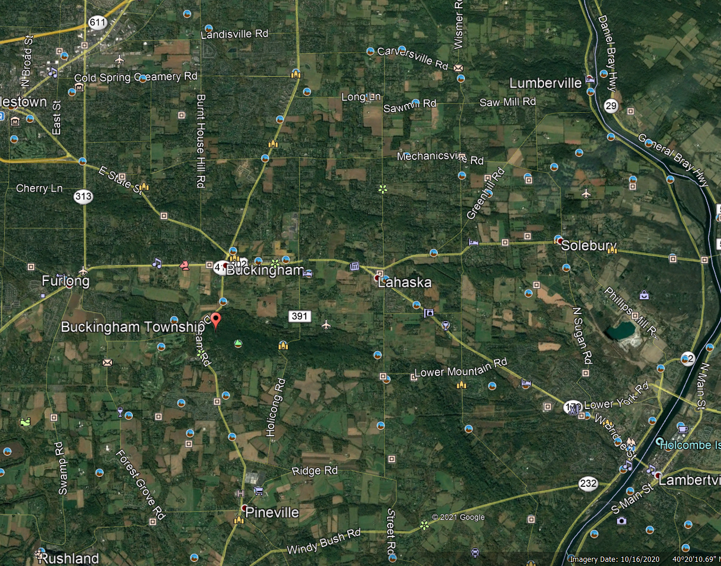
N
Notes:
In this 10/16/2020 Google Earth image, the perpendicular yellow lines at top center will be the focal point for the next several slides. The blue arrow at top right approximates the direction of North.
Note the proximity to Lahaska, PA, near the center. Doylestown, PA is nearly out of view at top left.
The horizontal yellow line at top center runs parallel to Carversville Road, whose name appears to the immediate right of this yellow line.

Slide 12
Notes:
The author of this presentation discovered this map, “Survey of Portions of Buckingham and Soulbury Townships: 1703” while exploring possible sources of information. The URL for the map is 17map.jpg (1023×663) (usgwarchives.net). usgwarchives.net appears to be a subset of the USGenWeb Project.
Might this map be the basis for the similar looking map outline contained in “Some Quaker Families: Scarborough|Haworth”?
Note the position of the perpendicular yellow lines. They highlight two sides of property titled “Geo. Wayworth.” An apparent misspelling of “Haworth?” “Soulbury Township” is currently spelled “Solebury Township.”
The horizontal yellow line and the right side of the “Wayworth” property line appear to touch “Pannacussing Creek.” (The current spelling is “Paunnacussing Creek.) The vertical, right-side property line runs along the dividing line between Buckingham and Soulbury Townships. This places George Haworth’s property in Buckingham Township.
Properties titled to John Scarborough and Wm. Scarborough appear below and slightly right of the dividing line. That places this John Scarborough property in Soulbury Township.

Slide 13
GPS: 40°21’51.57”N 75°05’22.55”W Pannacussing Creek is now spelled Paunnacussing Creek
Notes:
This map is sourced from “Some Quaker Families: Scarborough|Haworth”. Note again the repeat application of the perpendicular yellow lines, Pannacussing (sic) Creek, and Carversville Road. Durham Road and direction to Doylestown appear on the left.
The “Spring” identified just above and to the right of center does not seem to correspond to a pond (unidentified) that will appear on the two following Google Earth photos.
GPS coordinates appear at the top.

Slide 14
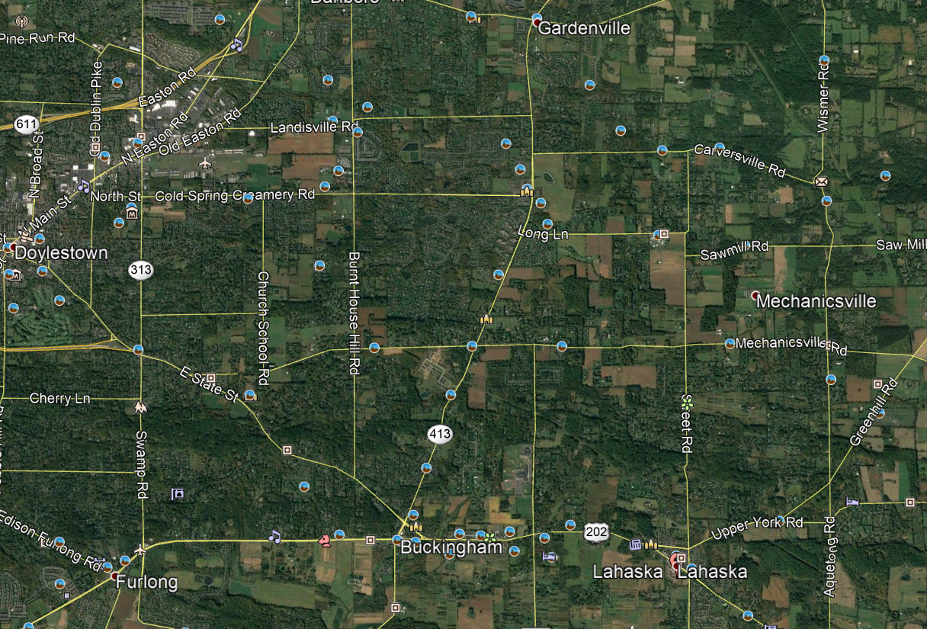
N
Notes:
This Google Earth view includes Doylestown, Buckingham, Gardenville, and Lahaska, PA.
Note the application of the perpendicular yellow lines to highlight the George Haworth property.

Slide 15
N
Notes:
A closer view.
Note the application of the perpendicular yellow lines to highlight the George Haworth property.

Slide 16
August 2019
40°21’46.39”N 75°05’34.06””W
Notes:
August 2019 Google Earth Street View of the George Haworth property.
GPS coordinates are displayed in the picture.
Note the street sign that shows “CARVERSVILLE RD” and (barely discernable) “DURHAM RD.”

Slide 17
Absalom Haworth – Locations:
(AFM) In 1739, James and Absalom moved from Bucks County, PA, to Smith Creek.

Slide 18
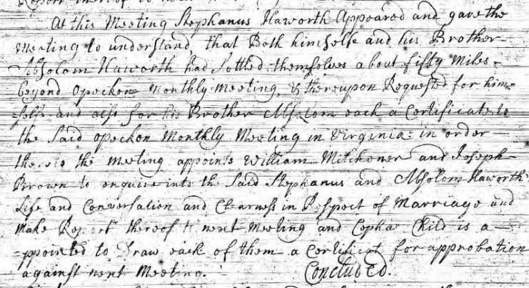
Departing Buckingham – MM 4th day of the 7th Month 1738 Ancestry.com - U.S., (Buckingham) Quaker Meeting Records, 1681-1935
Notes:
Reference: Ancestry.com –Buckingham Quaker Meeting Records, 1681-1935, Swarthmore College. Monthly Meeting held on the 4th day of the 7th month 1738.
Stephanus notifies the Monthly Meeting that he and his brother, Absalom, had settled themselves about 50 miles beyond Opockon Monthly Meeting and requested a certificate to a Monthly Meeting in Virginia.
(Note: by one account, Opockon became Opeckan, which in turn became Opecquon.)

Slide 19
Absalom Haworth – Locations:
N
Absalom’s Property - Back Creek Watershed
Notes:
Reference: Some Settler Sites in Back Creek Watershed, 1740. Map by Sam Lehman and Wilmer L. Kerris.
Map points to Absalom Haworth location in the Back Creek Watershed.
Absalom was a miller. He owned a mill in this area.
Note the close proximity to the West Virginia border.

Slide 20
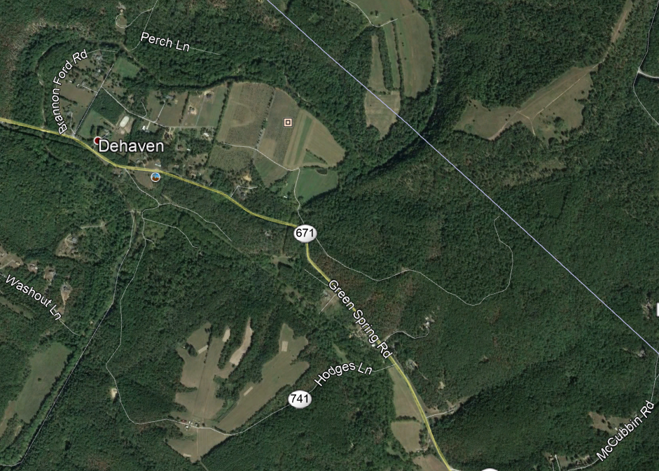
Absalom Haworth – Locations:
N
Google Earth View – Back Creek
Notes:
Google Earth overhead view pointing to area of Absalom Haworth’s property in the Back Creek Watershed.
The Virginia-West Virginia Border is the long, faint diagonal line across the top-right portion of the slide

Slide 21
Absalom Haworth – Locations:
Measurements of Virginia Land (Smith’s Creek)
Absalom Haworth 200 ac Lying on both Sides of Smiths Creek joining Stephanus Haworth Beginning at 2 white Oaks & a black oak in a hollow on the East Side of Smiths Creek Corner to Stephanus running thence with his line N 41 W 40 poles to a black Oak thence N 51 E 10 poles to a black Walnut on the Creek thence N 28 W 100 poles Crossing the Creek to a white Oak & pine thence N 61 E 240 poles to 2 white Oaks thence S 29 E 20 poles to the Creek thence S 29 E 80 poles to Daniel James Branch thence S 29 E 40 poles to a pine on the Eastside the (?said) branch thence S 60 W 240 poles to the Beginning.
11,688 feet
SQF, Pg. 3032
SQF, Pg. 3034
Notes:
Reference: Some Quaker Families – Scarborough/Haworth, Pgs. 3032 and 3034. Diagram prepared by Hugh O’Donnel.
The highlight enclosed portion is the property of Absalom.
Note the arrowed-line at top right pointing to “New Market, VA”
The yellow line, titled “11,688 feet,” running from bottom center to right center is the combined length of the distance from the southernmost point of Stephanus Haworth’s’ property to the easternmost point of Robert Scarborough’s property.
Note the references to Smiths Creek and Daniel James Branch within the measurements. Smiths Creek runs for miles in this area. Daniel James Branch was not located.

Slide 22
Size of Stephanus, Absalom, and Robert Scarborough Properties
N
Smith’s Creek
Smith Creek
Notes:
Google Earth image of Smith’s Creek, just south of New Market, VA.
The yellow line does not indicate the location of the property but provides a means to compare the 2.17-mile-long combined property line length against the town of New Market.

Slide 23
1. George Haworth 1674
Sarah Scarborough 1694
2. Absalom Haworth 1716
Elizabeth E. Payne 05 Dec 1724
3. Nathaniel Haworth 1740
Hannah Barrett
4. James Wade Haworth 06 Feb 1775
Anna Emily Coppock 29 Mar 1781
5. Joseph C. Haworth 07 Jul 1817
Elizabeth Coate 18 Sep 1812
6. Allen Haworth 13 Dec 1837
Harriett Stumppf 11 Dec 1845
7. Henry Haworth 17 Mar 1867
Edna Earl DeJamatt 17 May 1871
8. Allen Haworth 25 Sep 1904
Alice Ada Morehouse 21 Jul 1910
9. Wendell L. Haworth 07 Oct 1940
Judith A. Auvil 15 Jan 1940
Notes:
Presenter’s direct (all male) line to George (“the emigrant”) Haworth and Sarah Scarborough.

Slide 24
Families are…..One of God’s greatest treasures and the embodiment of all that is important in life.
Families are a refuge in good times and bad, a warm place of peace where acceptance reigns.
It matters not what you do or where you are, one thing you never doubt is your family. The members are always there, arms ready to embrace with healing hugs, and hearts with unconditional Love to share.
A family is a gift that is never completely unwrapped, it is a present for which each member is eternally thankful.
(Author Unknown)
Notes:
“Families are…” (author unknown)

