Slide 1
Haworth Association of America
haworthassociation.org

Slide 3
The Haworth Association of America
The web site was started in July, 1999 after the 300 year reunion
The domain name has been saved until July 2026 at Go Daddy
We use a remote server at Isomedia
The site contains: 2,600 pages, 5,209 picture and 6,938 files
The site uses 459,907 KB of space

Slide 7
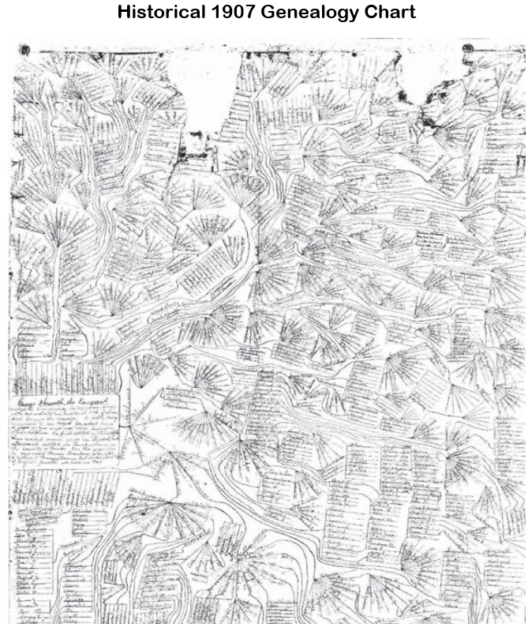

Slide 8
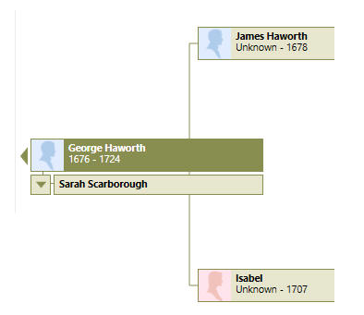
Database-File

